Slide 1
Update on Technical Meeting on Topical Issues on Safe Transport of Radioactive Material and Innovative Technologies
T5.9
Alenka BUJNOVA
NSRW/RIT/TSU - Transport Safety Specialist
TRANSSC 51
04 – 07 Nov 2025

Slide 2
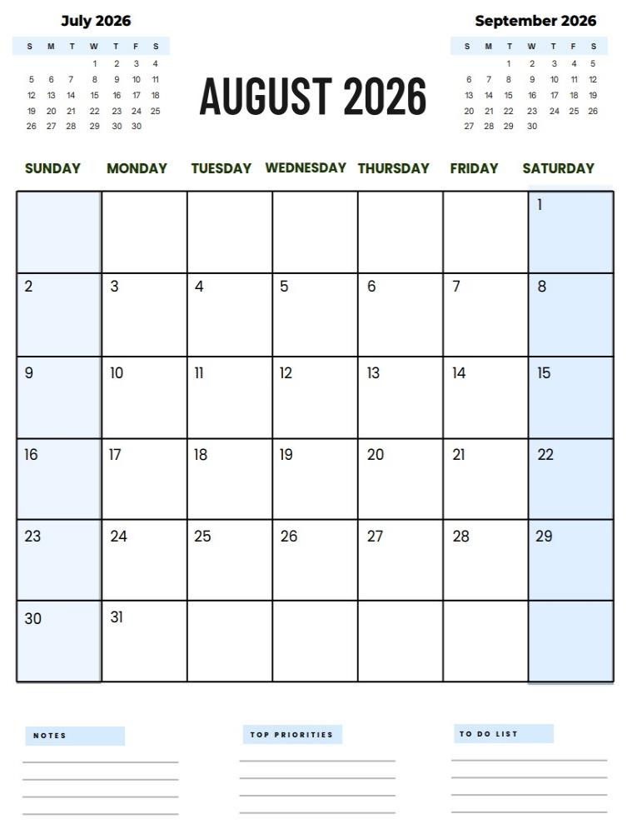
TM on Topical Issues on Safe Transport of Radioactive Material and Innovative Technologies
Implementation of SSR-6 requirements
Safe transport of SMRs & TNPPs
Conveyances with alternative fuels
Experiences with transport of SCO-III
Concept of Transport Index
Safety limits on seagoing vessels
Technical Meeting
EVT2505443
17 – 21 Aug 2026

Slide 3
TM on Topical Issues on Safe Transport of Radioactive Material and Innovative Technologies
Feedback and suggestions from TRANSSC on topics of interest for inclusion in the Technical Meeting are welcomed.
Technical Meeting
EVT2505443
17 – 21 Aug 2026

Slide 4
Thankyou!
a.bujnova@iaea.org

